Slide 1
2025 – MVT Signal Acquisition with FPGA
Sadie, Adriaan

Slide 2

Technology Project - 2025 Multi-voltage thresholding (mVT) Signal acquisition with FPGA
Tasks completed
Tasks left
Budget
Timeline
4. Motivation

Slide 3
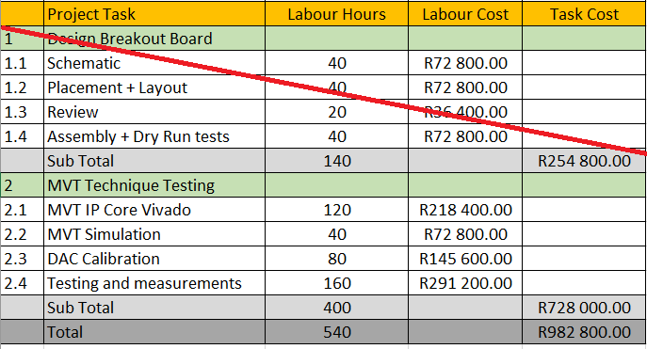
Technology Project: MVT with FPGA Tasks completed
Initial tasks complete Part of task 2.3 also completed

Slide 4
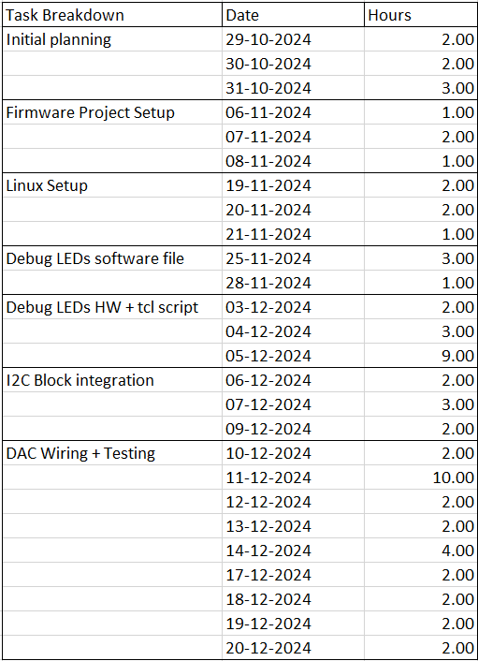
Technology Project: MVT with FPGA Tasks completed
Tasks completed for phase 2: Hours used for phase 2: 69 Hours in initial budget for phase 2: 400 (~R728000) Hours initially approved for phase 2: ~194 (R350000) Total usage for phase 2 of initial budget: ~36%

Slide 5
Technology Project: MVT with FPGA Tasks left
 | DACs need to be calibrated according to the LVDS inputs to the FPGA (will take longest time). Ramp-up needed to get everything up and running again Firmware block to be written that can measure offsets in LVDS voltages MVT IP core needs to be integrate with rest of firmware. JTAG-to-AXI core shall be integrated with firmware to allow for TCL-based control Sample signals must be measured with MVT technique and confirmed to be correct. Will stimulate the ports with sine wave Will use ILA to output data from MVT IP core and confirm functionality

Slide 6
Technology Project: MVT with FPGA Budget
Remaining hours from initial budget for phase 2:
400 – 69 = 331 hours for remaining tasks
~R629000 @ R1900/hour
Effort to finish within one month
Aiming to start at beginning of November

Slide 7

Technology Project: MVT with FPGA Timeline / Schedule
Timeline
Technology projects consistently hold a lower priority compared to customer assignments.
Consequently, our intention is to utilize this as an interim task between ongoing work, with the goal of completion by 2025.
RWR Seal Project takes priority.
1-2 days per week maximum on technology project, or full-time from November
Overtime can be considered
Resources only from HE Group

Slide 8
Technology Plan: MVT with FPGA motivation
Pros:
Cheaper alternative for ADCs
Simpler interface
Avoid obsolescence issues with highly specialised ADCs
Can be implemented on cheaper MPSoC FPGA devices
Compared to expensive RFSoC with internal ADCs
Only external component is slow, cheap, and common DAC
Once-off calibration
Can be used for next iteration of MAW-400, if proven
Cons:
Each bit requires a differential input, therefore, 12-bit ADC uses 12 differential pairs.

Slide 9
Technology Plan: MVT with FPGA References
Eliseev, D., et al. "An open-sorce IP-Core for Multi-Voltage Thresholding signal acquisition with FPGAs." Journal of Instrumentation 19.02 (2024): C02035.

Slide 10

http://www.saabgroup.com
Thank You

